Slide 1

One weekend.
One MVP.
NOV 6–8, 2026
BI STARTUP VILLAGE
NYDALSVEIEN 37, OSLO
VIBECODING HACKATHON
Nov 6–8, 2026
BI Startup Village
Notes:
Wait until the room is quiet. “Hi everyone, and welcome to Oslo Sprint! We're the Oslo Sprint team, and we've put this hackathon together as volunteers. We wanted to show what young people can do with AI in one weekend – and that's exactly what you're going to do. A big thank you to BI for lending us Startup Village all weekend. Before we tell you what's going to happen, we'll hand over to the Village team, who have some important info about the venue.”

Slide 2

The venue
and safety
17:05 · VILLAGE TEAM
A big thank you to BI for lending us Startup Village all weekend.
Emergency exits
Wi-Fi
Fire alarm meeting point: Outside the back entrance
Connect to BI-Guest and follow the sign-in steps that pop up on your screen.
Closing times
Your stuff
Friday 21:00 · Saturday 23:30. Opens at 09:00.
Night guards, but you're responsible for your own things.
Notes:
The Village team takes over. They go through emergency exits and the fire alarm meeting point, Wi-Fi, and that the venue closes at 21:00 on Friday and 23:30 on Saturday. There are guards at night, so it's safe to leave your gear, but everyone is responsible for their own things.

Slide 3
Friday
THE WEEKEND · 1/3
KICKOFF AND MINGLING
› 6 NOVEMBER
18:30
Mingling and team building
› Come up with ideas and pair up into teams
19:00
Plan and prep your idea
› Settle on the idea and plan with your team – no code until Saturday morning
21:00
Venue closes
› Stay as long as you like until then
Notes:
Friday 6 November: mingling and team building from 18:30, from 19:00 the evening is for prepping and planning your idea (no building yet), and the venue closes at 21:00. Building starts Saturday at 09:00.

Slide 4
Saturday
THE WEEKEND · 2/3
MAIN BUILD DAY
› 7 NOVEMBER
09:00
Doors open – building starts
› The starting gun – no code before this
12:00
Deadline: team photo and team name
13:00
Free Red Bull
› For participants aged 16 and over
14:00
Opera demo presentation
› Opera presents new products – open to everyone
16:00–17:00
Jury panel discussion
› Get to know the jury and ask any question you might have
18:00
Domino’s Pizza
› Dinner sponsored by Domino’s
23:30
Venue closes
› Stay as long as you like until then
Notes:
Saturday 7 November is the main build day. Doors open at 09:00 and building starts – this is the starting gun. Deadline for team photo and team name is 12:00. Free Red Bull at 13:00 (16 and over), Opera demo at 14:00, jury panel discussion 16–17 and Domino’s pizza at 18:00. The venue closes at 23:30.

Slide 5
Sunday
THE WEEKEND · 3/3
DEMO DAY
› 8 NOVEMBER
09:00
Doors open — building continues
12:00–13:00
Wybe challenge
14:00
Building deadline
› Deliver your final product
14:15–17:00
Mini-pitch from each team
› For the jury only: 2 min pitch + 1 min questions. The 10 best go on to the final
17:00
Finalists announced
18:00
Pitching competition
› The finalists pitch for the win – 5–10 minutes per team
21:00
Prize awarding
› Side-challenge prizes and the NOK 50,000 first prize, sponsored by Opera
Notes:
Sunday 8 November is demo day. The Wybe challenge runs from 12:00 to 13:00. Building deadline at 14:00. From 14:15 every team pitches to the jury: 2 minutes plus 1 minute of questions. While you are not pitching there is mingling and activities. Finalists and side-challenge winners are announced at 17:00, the pitching competition is at 18:00, where each finalist pitches for 5–10 minutes, and prizes are awarded at 21:00.

Slide 6
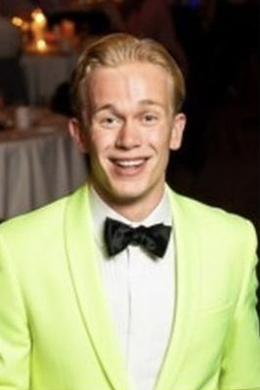
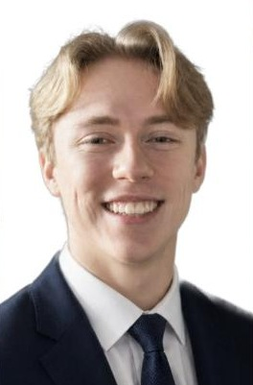


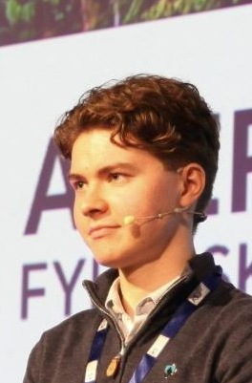
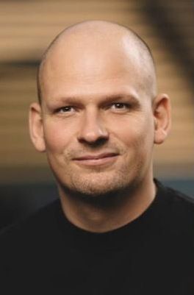

Meet the jury
THE JURY · 1/3
FOUNDERS
FOUNDERS
August Sandmo
Einar Holt
Co-founder and CEO, Vaskeladden
Founding Engineering Lead, Wybe Robotics
Vaskeladden
FOUNDERS
FOUNDERS
Oscar Gangstad Westbye
Martin Schi Nordvold
Founding engineer, Wybe Robotics · founder, Tenki Labs
Head of Holio
Notes:
Present the jury by category. Founders: August Sandmo (Vaskeladden), Einar Holt and Oscar Gangstad Westbye (Wybe Robotics), Martin Schi Nordvold (Holio).

Slide 7
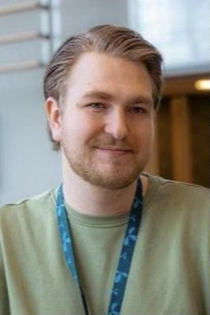
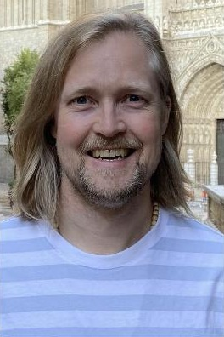



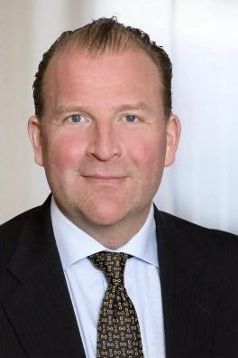

Meet the jury
THE JURY · 2/3
IT SPECIALISTS
IT SPECIALISTS
Daniel Christensen
Pål de Vibe
Ethical hacker, Telenor
Principal Data Engineer, Knowit
PRODUCT LEADERS
LEGAL EXPERTS
Henrik Lexow
Nils Holger Koefoed
Senior AI Product Director, Opera
Partner, Ro Sommernes law firm
RO SOMMERNES
Notes:
IT specialists: Daniel Christensen (Telenor) and Pål de Vibe (Knowit). Product leaders: Henrik Lexow (Opera). Legal experts: Nils Holger Koefoed (Ro Sommernes).

Slide 8

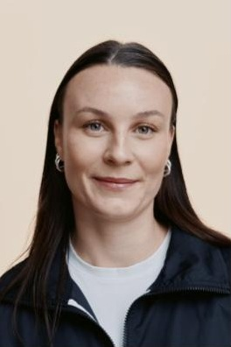


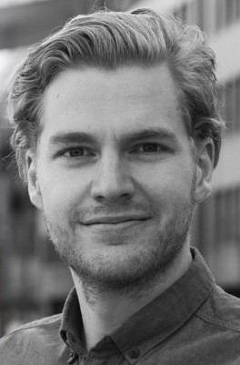
Meet the jury
THE JURY · 3/3
DESIGNERS AND MARKETERS
DESIGNERS AND MARKETERS
Mi Le Hagen
Andrea Claussen
Founder of Aukonomi · Lecturer in digital marketing, Gokstad Akademiet
Senior Digital Designer, Knowit Experience
DESIGNERS AND MARKETERS
Chris Mansfeldt
SATURDAY 16–17
Creative lead and product marketer, Opera
Panel talk
Ask the jury your questions directly.
Notes:
Designers and marketers: Mi Le Hagen (founder of Aukonomi, lecturer at Gokstad Akademiet), Andrea Claussen (Knowit Experience), Chris Mansfeldt (Opera). Two people from Opera are on the jury. Remind everyone of the panel talk on Saturday 16–17, where teams can ask the jury questions directly.

Slide 9





CHALLENGES
Notes:
Transition into the challenges: first the main prize from Opera, then the side challenges from Wybe, Holio and ElevenLabs.

Slide 10


NOK 50,000
×
Jury prize sponsored by Opera
MAIN PRIZE
SATURDAY 14:00 · DEMO FROM OPERA · TWO FROM OPERA ON THE JURY
Notes:
“The winning team gets NOK 50,000, sponsored by Opera. Opera was founded right here in Oslo in 1995 and makes browsers used by hundreds of millions of people – including Opera GX and the AI browser Opera Neon. Two people from Opera are on the jury, and on Saturday at two o'clock they'll show off new products.”

Slide 11
One weekend.
One finished product.
Website
App
Game
Tool
17:15 · THE CHALLENGE
Anything goes. It doesn't have to be perfect, but it has to work well enough to show off the idea and its main features.
Notes:
“You have one weekend to build a finished product. It can be an app, a website, a game, a tool – anything. It doesn't have to be perfect, but it has to work well enough for you to show off the idea and its main features.”

Slide 12
Rules
STRICTLY ENFORCED
1
Teams
Teams of 1–4 participants. No external people may be used to build.
2
Tools
AI and all other tools are allowed. Vibecode as much as you like.
3
Existing code
Not allowed.
4
Deadline
Sunday 14:00 — deliver your final product.
5
What to submit
All files (finished product).
6
Pitch
Every team pitches for 2 minutes + 1 minute of questions.
7
Judging
A jury of developers, experts and founders picks the finalists and winners.
Cheating, harassment or discrimination can get you removed from the event.
Notes:
Go through the rules clearly – they are strictly enforced. Teams of 1–4, and no outside people may help build. AI and all other tools are allowed – vibecode as much as you like. No existing code. Deadline Sunday 14:00: deliver your final product, all files. Every team pitches for 2 minutes plus 1 minute of questions, and a jury of developers, experts and founders picks the finalists and winners. Also mention that cheating, harassment or discrimination can get you removed.

Slide 13


Three extra challenges
SIDE CHALLENGES · SEPARATE PRIZES
Wybe Night Shift
Holio: warehouse ops
ElevenLabs
Build the brain of a robot working the night shift at a hotel. Robotics and AI.
Solve a real challenge from the warehouse behind online shopping.
Best product built with ElevenLabs.
PRIZE: 6 MO SCALE ($1,794)
MAIN PRIZE NOK 10,000
PRIZE: NOK 10,000
Notes:
Wybe has a robotics and AI challenge – the robot will tell you more about it shortly. Holio has its own e-commerce challenge with its own prize (next slides). ElevenLabs: best product built with ElevenLabs wins 6 months of ElevenLabs Scale ($1,794).

Slide 14
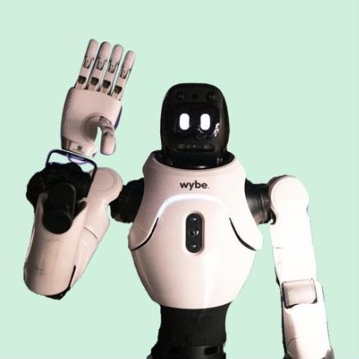
Wybe
Night Shift
17:35 · SIDE CHALLENGE
A robot is working the night shift at Hotel Wybe.
You are its brain.
MAIN PRIZE NOK 10,000
Notes:
The robot takes the floor, greets everyone and presents the Wybe challenge. Agree on the lines with Wybe beforehand, e.g.: “Hi, I'm Wybe – a robot employee from Moss. I'll be here all weekend, so come over and say hi. I have a challenge just for you – my team will explain it now. Good luck!” Afterwards someone from Wybe can take a couple of minutes to explain the challenge and the prize (next two slides).

Slide 15
How it works
WYBE NIGHT SHIFT
1
Your team joins through one link – no key needed. That's all you get.
JOIN THE CHALLENGE
2
Your agent has to figure out which commands the robot understands.
nightshift-board.wybe.me/join
3
The night manager sends tasks: towels, lost items, room checks. There are always more than anyone can finish.
NO KEY NEEDED
Open the link and sign up your team – that's it.
4
Surprises along the way. Good judgement earns points, careless actions cost points.
5
Sunday: a final on new, secret scenarios. That's what counts for the prize.
Anything goes, as long as it talks to the address. A laptop and internet is all you need.
Notes:
Wybe explains the challenge. Don't share anything beyond this – figuring things out on your own is the challenge. If they ask how the API works: “Ask the robot.” Teams join at nightshift-board.wybe.me/join – no key needed. Teams pay for any AI services themselves. Technical problems with the server: send them to Wybe's stand.

Slide 16
Prize and final
WYBE NIGHT SHIFT · MAIN PRIZE
WYBE SIDE PRIZE
NOK 10,000
to the team with the highest average score in the final
FRI–SUN
SUN 11:45
SUN 12–13
SUN 13:05
Practice – doesn't count
Practice closes
Final: 10 secret shifts
Results on screen
One team, one key · The agent runs on its own in the final · Don't attack or overload the server
Notes:
Points for every task the robot actually completes – faster earns more. Deductions for wrong deliveries, for claiming something is done when it isn't, and for unsafe choices. The average of the team's final shifts decides, with the worst shift dropped. The main prize of NOK 10,000 goes to the team with the highest average score. Times are provisional and will be aligned with the programme.

Slide 17
Make life easier
in the warehouse
SIDE CHALLENGE · HOLIO
Holio is the software that runs the warehouse behind online stores: incoming orders, stock on the shelves, packing, shipping labels and returns.
Receiving
Storage
Picking
Packing
Shipping
Returns
The task
Holio Side Prize
Pick one of nine real challenges from warehouse operations and show a solution for the people working there. No prior knowledge needed.
NOK 10,000
Notes:
Holio has its own e-commerce challenge with its own prize. Holio is the system that runs the warehouse behind online stores – orders, stock, packing, shipping and returns. Teams pick one of nine pain points from warehouse operations and show a solution. The prize is NOK 10,000. The full description is in the Holio document on Discord.

Slide 18
Nine warehouse challenges
HOLIO · PICK ONE
1
Missing dimensions
2
Manual delivery notes
3
No barcode
Measure with the phone camera
Read them from a photo
Recognise from a photo
4
Wrong item in the box
5
Wrong box size
6
Long walks
Camera check before sealing
Suggest a box from the order
Shorter picking route
7
Stock counts and shrinkage
8
Assessing returns
9
Training
Find shelves with errors
Guided, with photos
Guidance in their own language
The directions are just examples – how you solve it is up to you.
Notes:
Nine real challenges from warehouse operations: 1 missing product dimensions, 2 delivery notes typed in by hand, 3 items without barcodes, 4 wrong item or quantity in the box, 5 wrong box size, 6 long walks when picking, 7 stock counts and shrinkage, 8 assessing returns, 9 training new staff. Teams pick one. The full description is in the Holio document.

Slide 19

Give your product a voice
SIDE CHALLENGE · ELEVENLABS
THE CHALLENGE
FOR ALL PARTICIPANTS
Best product built with ElevenLabs
Free Creator subscription
How to get it: In the discord
Use ElevenLabs in your product – the best one wins.
PRIZE
6 months of ElevenLabs Scale
$299 / month · total value $1,794
Notes:
Thank ElevenLabs, who give everyone a free Creator subscription – explain how participants get it. The ElevenLabs challenge: the best product built with ElevenLabs wins. The prize is 6 months of the ElevenLabs Scale subscription – worth $299 a month, $1,794 in total.

Slide 20
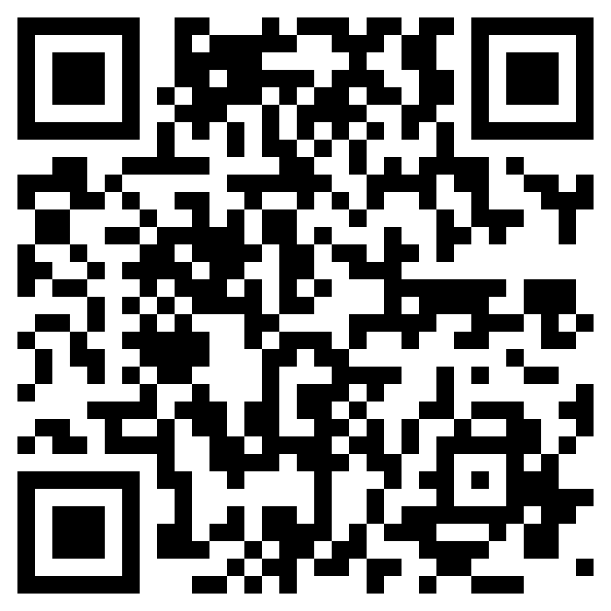
All the info is
on Discord
DISCORD
Everything about the weekend
Schedule, rules, side challenges and updates – all in one place.
Digital mentors
Stuck? Reach out to our mentors there – they'll help you move forward.
SCAN TO JOIN
discord.gg/yGu4xxftmB
Notes:
All info about the weekend is on the Discord server: schedule, rules and updates. You can also reach some of our digital mentors there if you get stuck. Scan the QR code or go to discord.gg/yGu4xxftmB.

Slide 21









Thank you!
SPONSORS AND PARTNERS
Main sponsor
Venue host
Side challenge
Side challenge
Side challenge
Sponsor
Sponsor
Sponsor
Sponsor
The food
PHOTO AND VIDEO
We're taking photos and video all weekend. Don't want to be in them? Just let us know.
Notes:
Thank ElevenLabs, who give everyone a free Creator subscription, and Daniel Christensen, Aukonomi, O3C, Best Emballasje and Domino’s, who provide the food. Finally: we'll be taking photos and video all weekend. If you don't want to be in a photo, let the photographer know.

Slide 22



Questions?
17:40
Notes:
Take a few questions from the audience before team forming.

Slide 23
Find your team
17:50 · MINGLING AND TEAM FORMING
GOT A TEAM
SOLO / WANT MORE PEOPLE
BEFORE 19:00
Find your spot
Meet at the secondary stage
Register your team
Sit together and nail down your idea.
New teams register with one of us. Max four per team.
Got an idea? Pitch it in 20 seconds – then people join the idea they want to work on.
Plan and discuss as much as you like – but no code before building starts on Saturday at 09:00.
Notes:
Explain team forming: those who already have a team find their spot. Those who are solo or want more people gather at the front of the room. Anyone with an idea gets 20 seconds to pitch it, then people go to the idea they want to work on. New teams register with one of us before 19:00. Someone from the OS team helps anyone who's on their own.

Slide 24

Plan!
FRIDAY EVENING · PLANNING TIME
Tonight is for prepping and planning your idea. Building starts Saturday at 09:00, and you have until Sunday at 14:00. The venue is open until 21:00 tonight.
JOIN THE DISCORD
discord.gg/yGu4xxftmB
GOOD LUCK · OSLOSPRINT.ORG
Notes:
Gather everyone one last time and count down from ten: “Oslo Sprint is officially on! Tonight is for prepping and planning your idea with your team – no code yet. Building starts tomorrow at nine, and you have until two o'clock on Sunday. The venue is open until nine tonight. Good luck!” Point to the QR code for anyone not yet on Discord.

